Slide 1
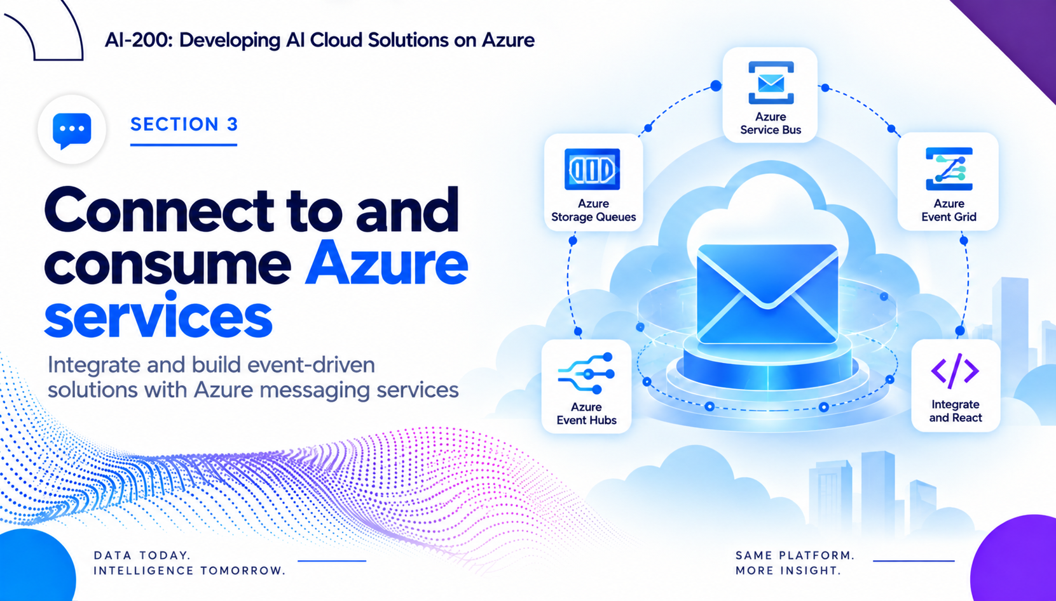
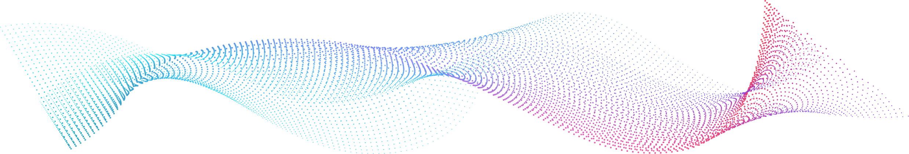

Slide 2
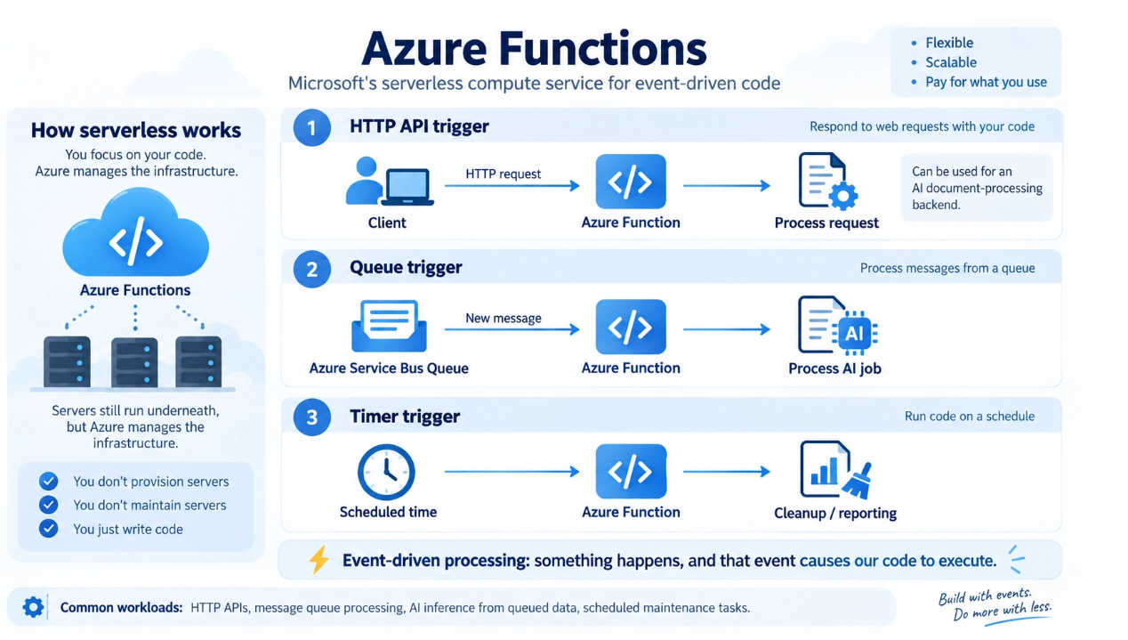
What are Azure Functions
  Azure Functions is Azure’s serverless compute service for running small units of code in response to events, requests, or schedules. You focus on writing business logic, while Azure manages the infrastructure.
  It is event-driven, which means the function runs only when something happens — for example, an HTTP request arrives, a queue message is received, or a timer schedule is reached.
  Azure Functions is a strong fit for lightweight APIs, background jobs, queue processing, scheduled tasks, and integration workflows, especially when applications need to react to other Azure services.
  Azure Functions also supports multiple languages and flexible hosting options, making it easier to build cloud-native solutions that integrate with services like Service Bus, Event Grid, Storage, and Cosmos DB.

Slide 3
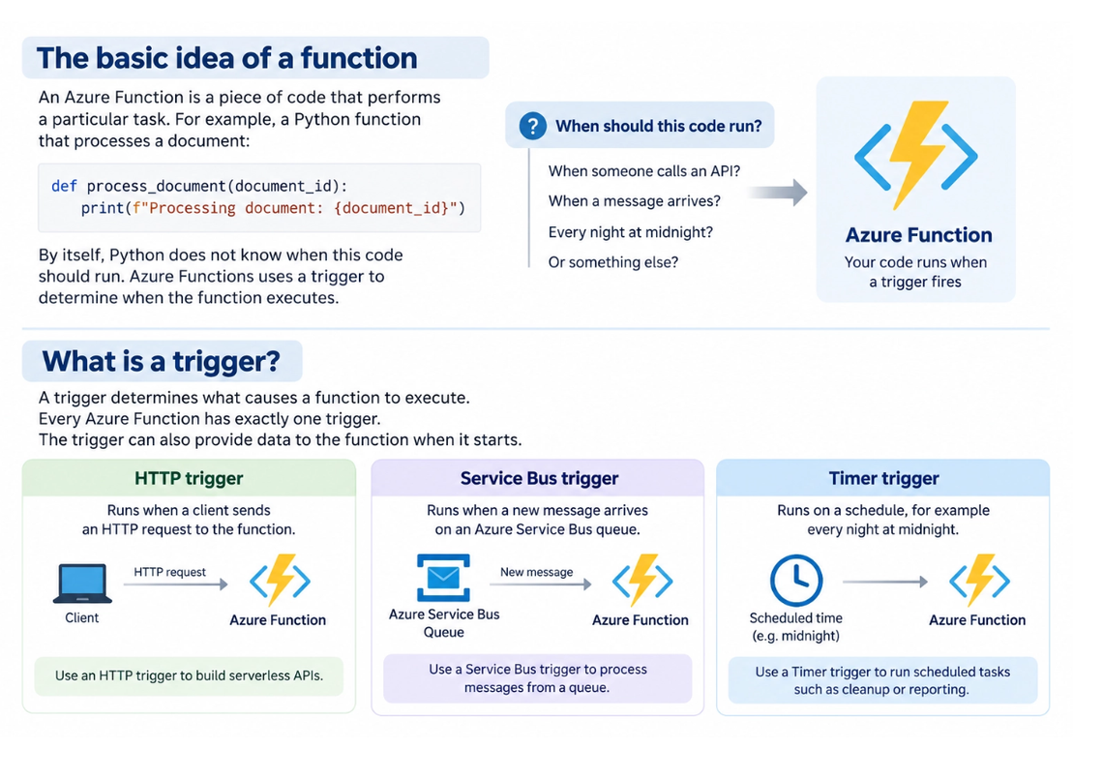
Triggers
  A trigger is what starts a function. Every Azure Function must have exactly one trigger, and that trigger defines when the function code should execute.
  Triggers are commonly based on events or actions, such as an HTTP request, a new message in Azure Service Bus or Storage Queue, or a Timer schedule.
  The trigger often provides input data to the function. For example, an HTTP trigger passes request data, while a queue trigger passes the message payload that needs to be processed.
  Triggers are what make Azure Functions event-driven. Instead of continuously polling or keeping custom background services running, Azure responds automatically when the trigger condition is met.

Slide 4
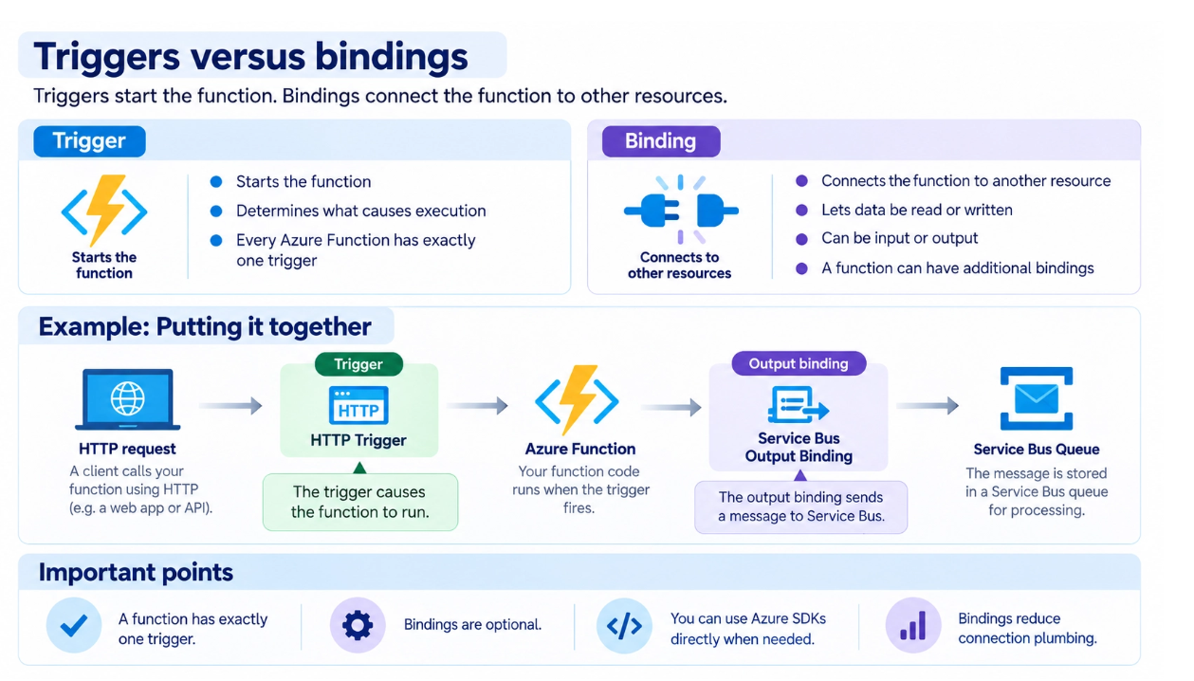
Triggers vs bindings
  Triggers start the function, while bindings connect the function to other services. A simple way to explain it is: the trigger decides when the function runs, and bindings help define what the function reads from or writes to.
  A function has exactly one trigger, but it can have zero, one, or many bindings depending on the scenario. Bindings are optional and help reduce repetitive connection code.
  Input bindings bring data into the function from another resource, while output bindings send data out to another resource. For example, a function might be triggered by HTTP and then write a message to Service Bus using an output binding.

Slide 5
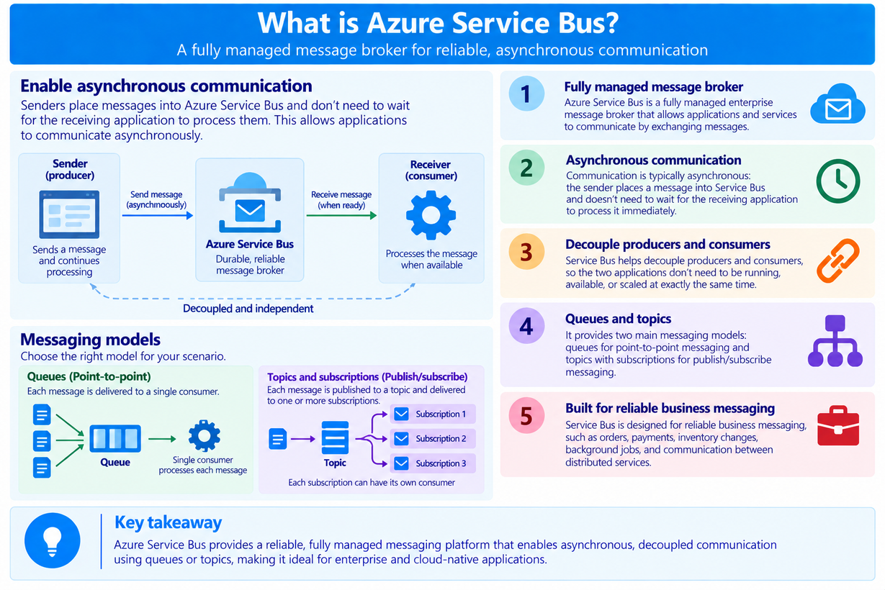
What is Azure Service Bus?
  Azure Service Bus is a fully managed enterprise message broker that allows applications and services to communicate by exchanging messages.
  Communication is typically asynchronous: the sender places a message into Service Bus and doesn't need to wait for the receiving application to process it immediately.
  Service Bus helps decouple producers and consumers, so the two applications don't need to be running, available, or scaled at exactly the same time.
  Service Bus is designed for reliable business messaging, such as orders, payments, inventory changes, background jobs, and communication between distributed services.

Slide 6
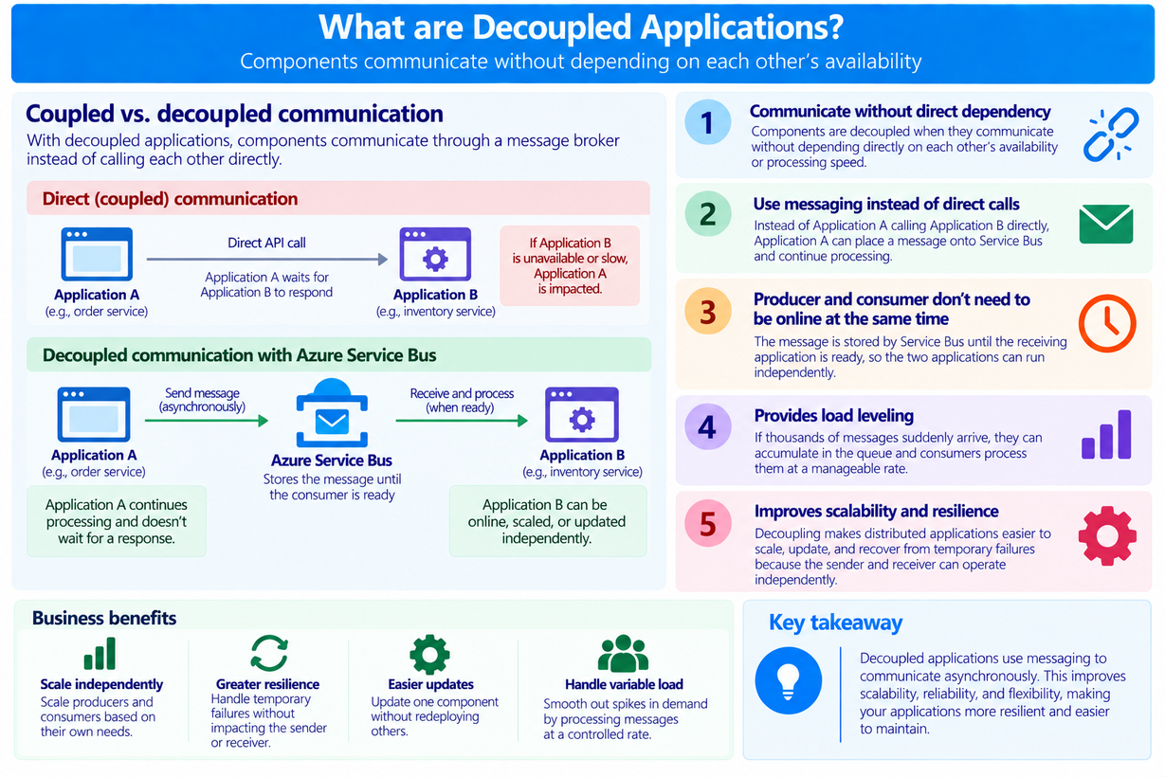
What are Decoupled Applications?
  Applications are decoupled when components communicate without depending directly on each other's availability or processing speed.
  Instead of Application A calling Application B directly, Application A can place a message onto Service Bus and continue processing.
  The message is stored by Service Bus until the receiving application is ready, meaning the producer and consumer don't have to be online at the same time.
  Decoupling makes distributed applications easier to scale, update, and recover from temporary failures because the sender and receiver can operate independently.

Slide 7
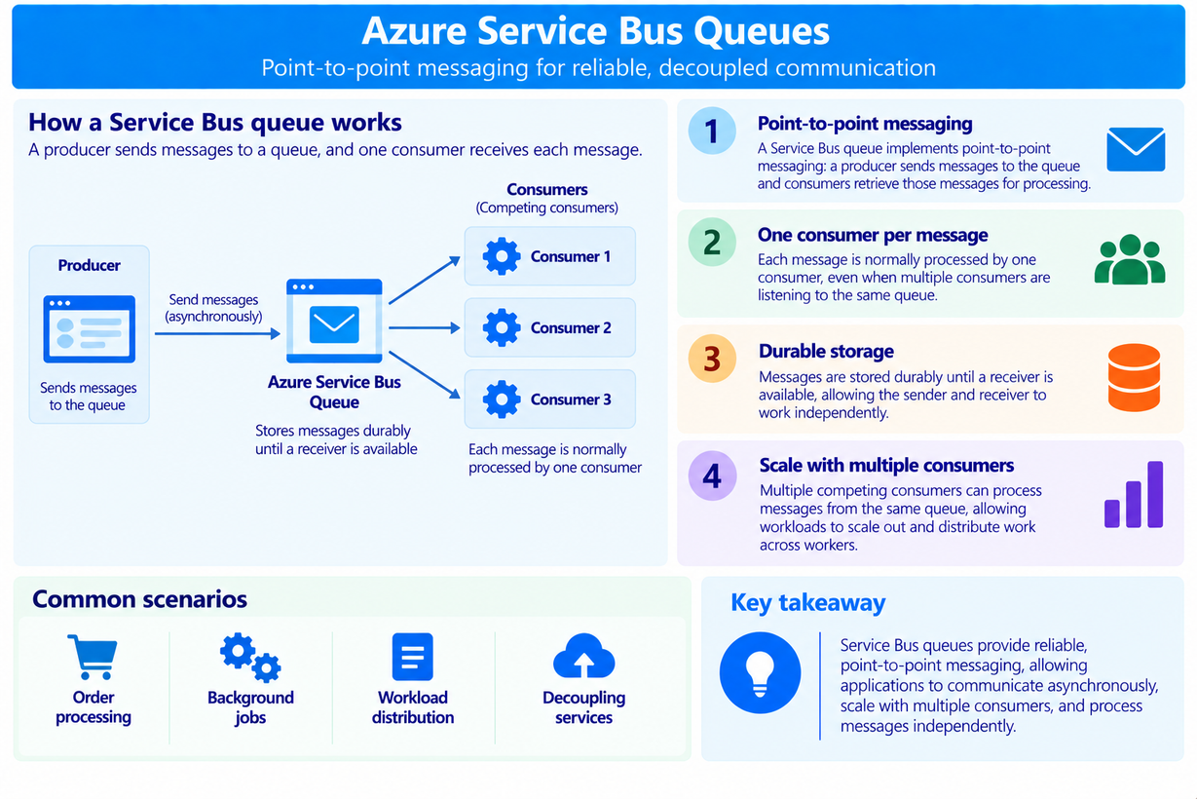
Azure Service Bus Queues
  A Service Bus queue implements point-to-point messaging: a producer sends messages to the queue and consumers retrieve those messages for processing.
  Each message is normally processed by one consumer, even when multiple consumers are listening to the same queue.
  Messages are stored durably until a receiver is available, allowing the sender and receiver to work independently.
  Multiple competing consumers can process messages from the same queue, allowing workloads to scale out and distribute work across workers.

Slide 8
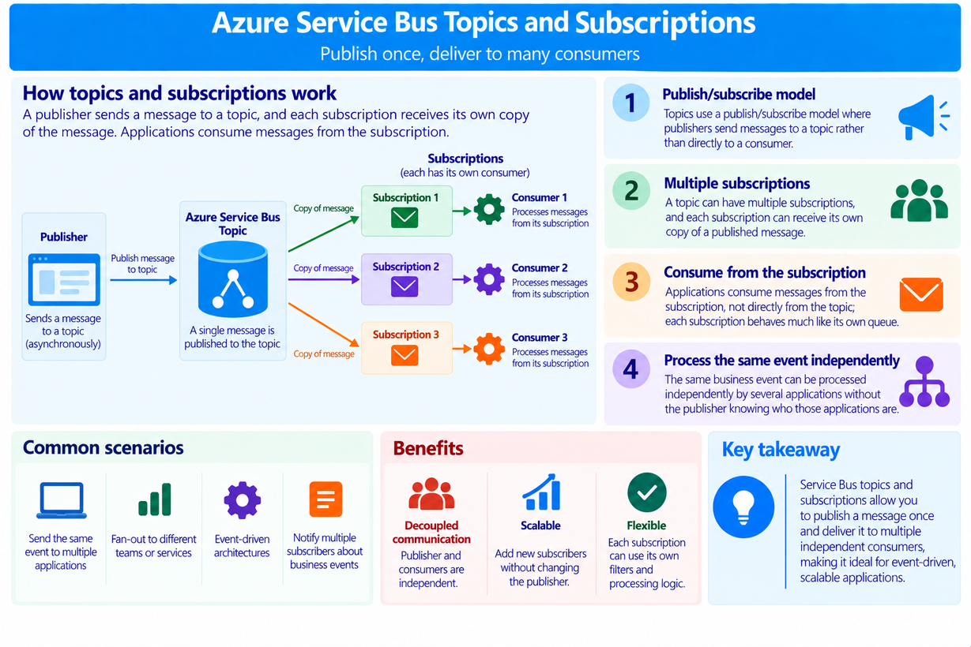
Azure Service Bus Topics and Subscriptions
  Topics use a publish/subscribe model where publishers send messages to a topic rather than directly to a consumer.
  A topic can have multiple subscriptions, and each subscription can receive its own copy of a published message.
  Applications consume messages from the subscription, not directly from the topic; each subscription behaves much like its own queue.
  This allows the same business event to be processed independently by several applications without the publisher knowing who those applications are.

Slide 9
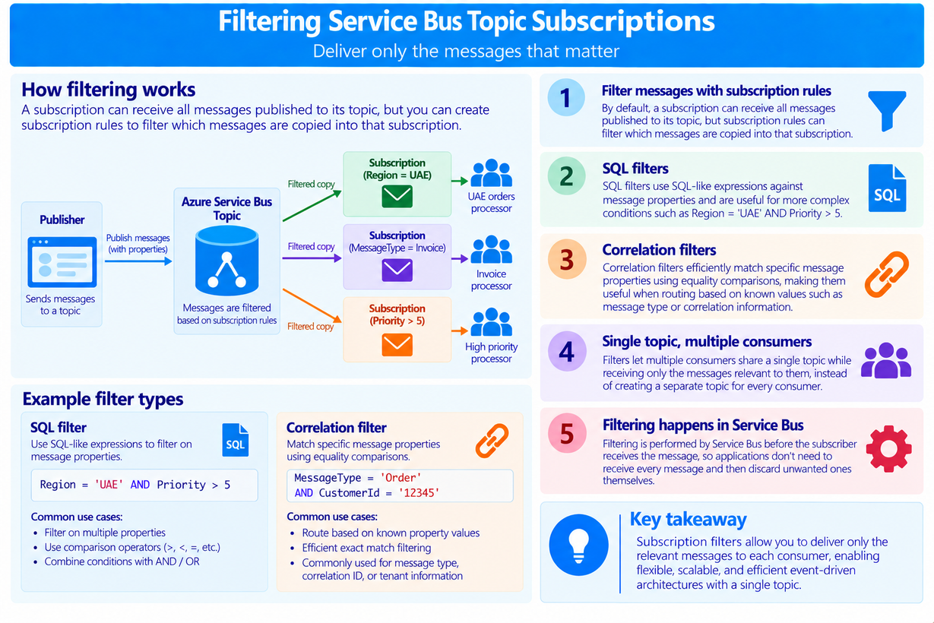
Filtering Service Bus Topic Subscriptions
  By default, a subscription can receive all messages published to its topic, but subscription rules can filter which messages are copied into that subscription.
  SQL filters use SQL-like expressions against message properties and are useful for more complex conditions such as Region = 'UAE' AND Priority > 5.
  Correlation filters efficiently match specific message properties using equality comparisons, making them useful when routing based on known values such as message type or correlation information.
  Filters let multiple consumers share a single topic while receiving only the messages relevant to them, instead of creating a separate topic for every consumer.

Slide 10
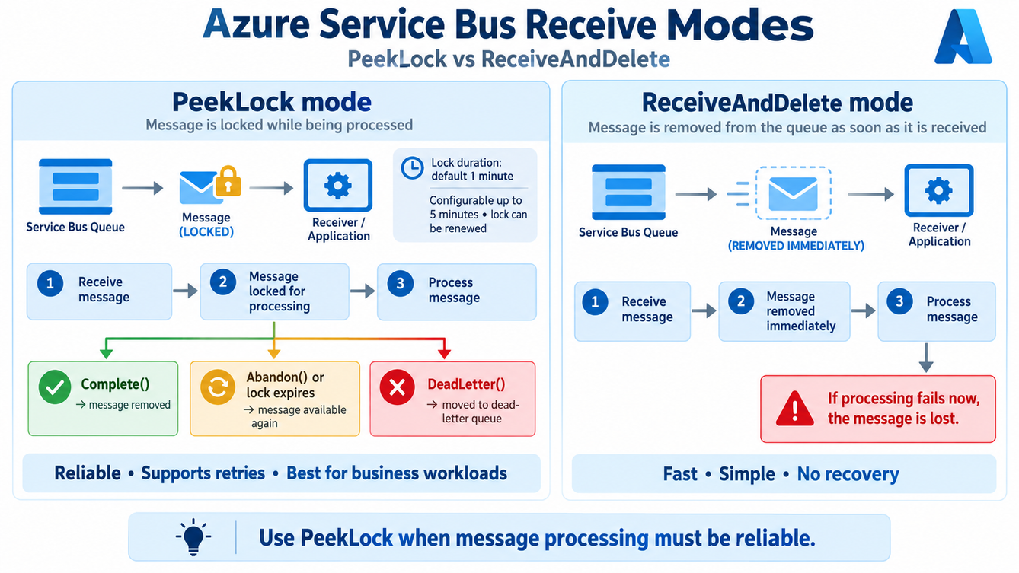
How messages are received from Azure Service Bus queues
  Azure Service Bus supports two receive modes: PeekLock and ReceiveAndDelete. These modes define what happens to a message when a receiver reads it from the queue. In most business applications, PeekLock is the safer and more common mode because it supports reliable processing and retries.
  In PeekLock mode, Service Bus sends the message to the receiver and places an exclusive lock on it so that other consumers cannot process the same message at the same time. The message is not removed immediately. The queue or subscription defines the lock duration, and the default lock duration is 1 minute. This can be configured, up to a maximum of 5 minutes, and the receiver can renew the lock if processing takes longer.

Slide 11
How messages are received from Azure Service Bus queues
  In PeekLock mode, the complete flow is: receive the message → process the message → explicitly settle it. If processing succeeds, the receiver must call Complete so Service Bus removes the message from the queue. If processing fails but should be retried, the receiver can Abandon the message, or let the lock expire so the message becomes available again. If the message cannot be processed successfully, it can be dead-lettered for later inspection.
  In ReceiveAndDelete mode, the message is considered consumed as soon as Service Bus sends it to the receiver. The receiver does not need to call Complete, but this also means that if processing fails after receipt, the message is lost. This mode is faster and simpler, but it is usually only appropriate for low-value or short-lived data where occasional loss is acceptable.

Slide 12
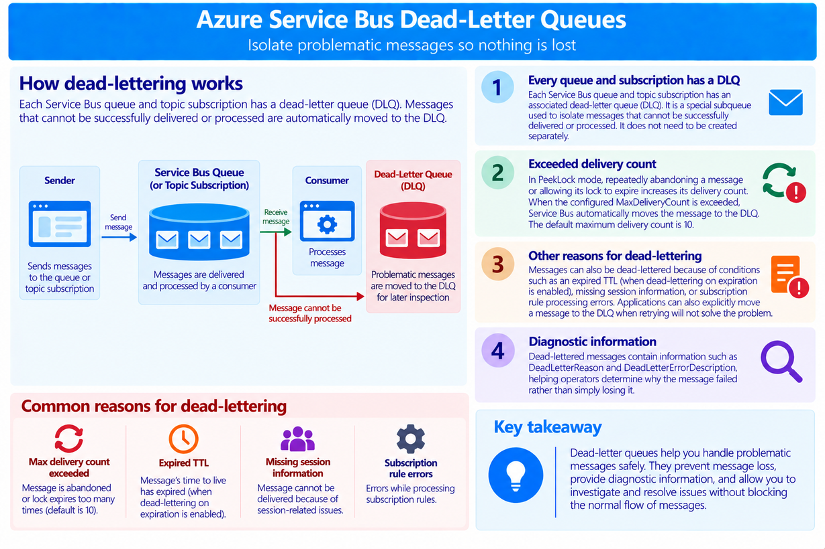
Azure Service Bus Dead-Letter Queues
  Every Service Bus queue and topic subscription has an associated dead-letter queue (DLQ). It is a special subqueue used to isolate messages that cannot be successfully delivered or processed.
  In PeekLock mode, repeatedly abandoning a message or allowing its lock to expire increases its delivery count. When the configured MaxDeliveryCount is exceeded, Service Bus automatically moves the message to the DLQ. The default maximum delivery count is 10.
  Messages can also be dead-lettered because of conditions such as an expired TTL when dead-lettering on expiration is enabled, missing session information, or subscription rule processing errors. Applications can also explicitly move a message to the DLQ when retrying will not solve the problem.

Slide 13
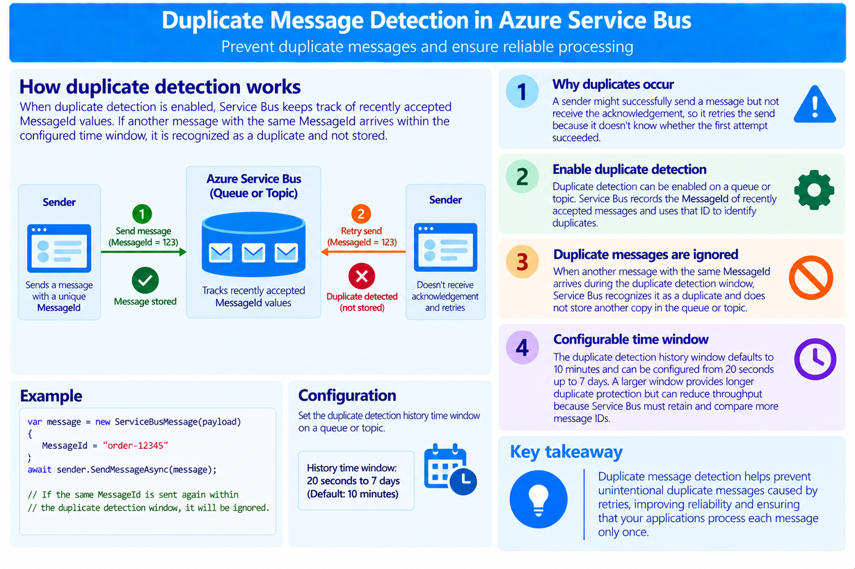
Duplicate Message Detection
  Duplicate messages can occur when a sender successfully sends a message but doesn't receive the acknowledgement, causing the application to retry the send because it doesn't know whether the first attempt succeeded.
  Azure Service Bus can enable duplicate detection on a queue or topic. Service Bus records the MessageId of recently accepted messages and uses that ID to identify duplicates.
  When another message with the same MessageId arrives during the duplicate detection window, Service Bus recognizes it as a duplicate and does not store another copy in the queue or topic.

Slide 14
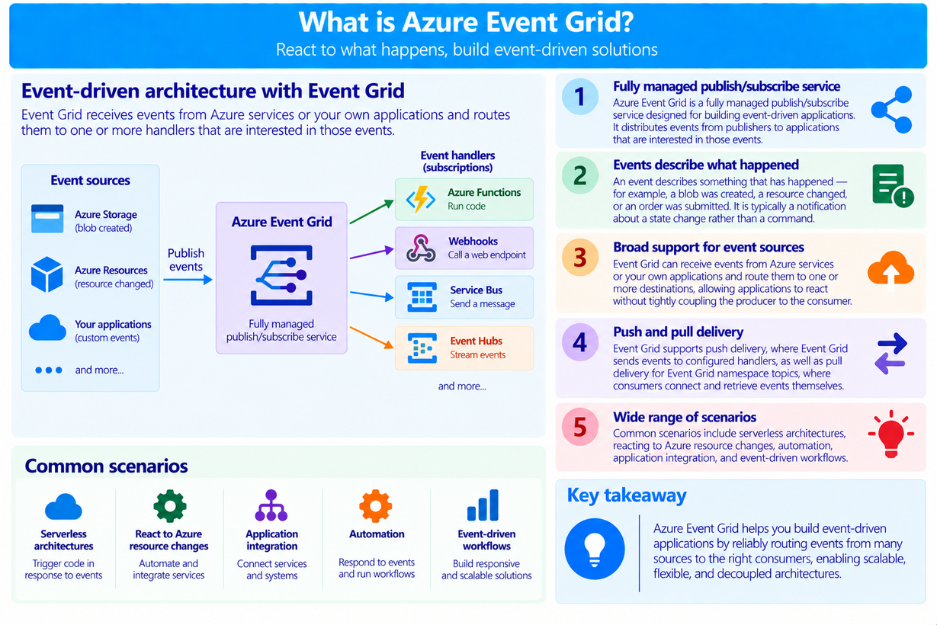
What is Azure Event Grid?
  Azure Event Grid is a fully managed publish/subscribe service designed for building event-driven applications. It distributes events from publishers to applications that are interested in those events.
  An event describes something that has happened — for example, a blob was created, a resource changed, or an order was submitted.
  Event Grid can receive events from Azure services or your own applications and route them to one or more destinations, allowing applications to react without tightly coupling the producer to the consumer.
  Common scenarios include serverless architectures, reacting to Azure resource changes, automation, application integration, and event-driven workflows.

Slide 15
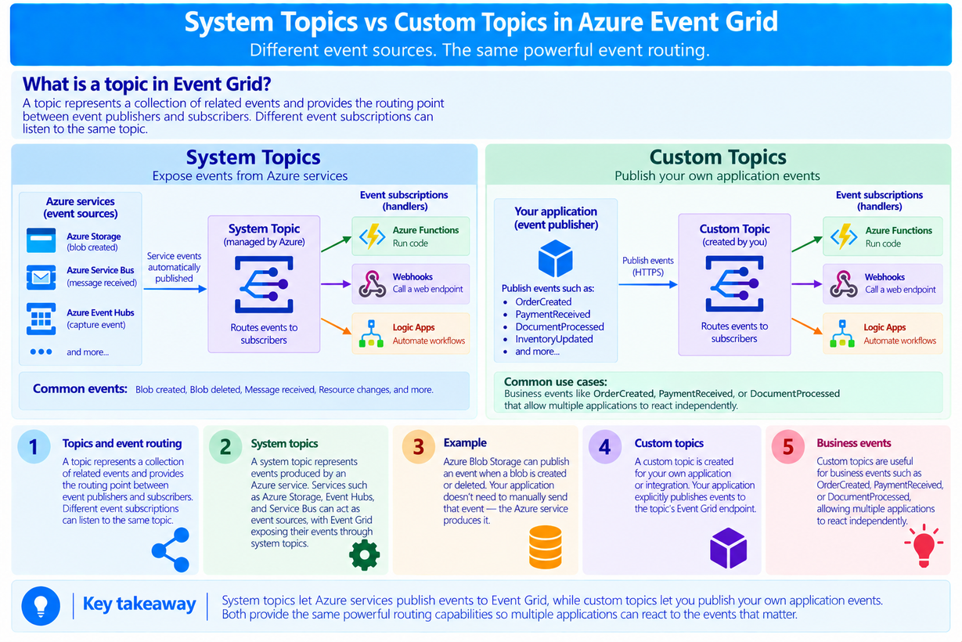
System Topics vs Custom Topics
  An Event Grid topic represents a collection of related events and provides the routing point between event publishers and subscribers. Different event subscriptions can listen to the same topic.
  A system topic represents events produced by an Azure service. Services such as Azure Storage, Event Hubs, and Service Bus can act as event sources, with Event Grid exposing their events through system topics.
  A custom topic is created for your own application or integration. Your application explicitly publishes events to the topic's Event Grid endpoint.
  Custom topics are useful for business events such as OrderCreated, PaymentReceived, or DocumentProcessed, allowing multiple applications to react independently.

Slide 16
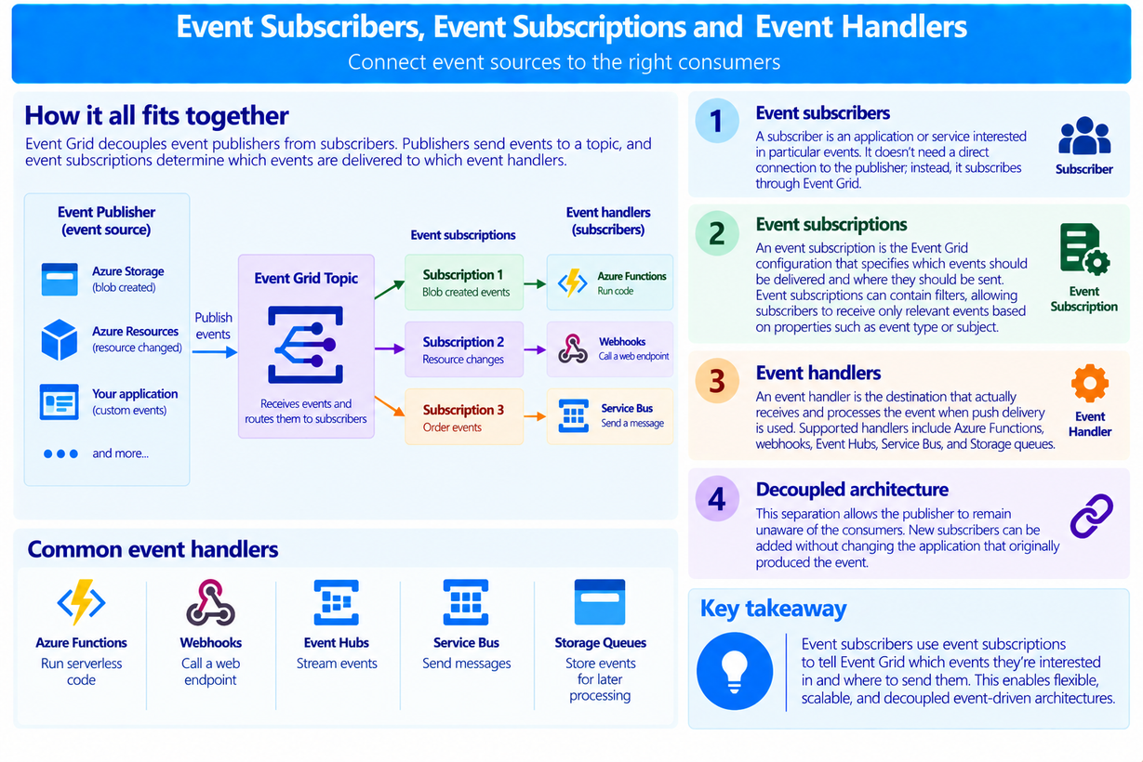
Event Subscribers, Event Subscriptions and Event Handlers
  A subscriber is an application or service interested in particular events. It doesn't need a direct connection to the publisher; instead, it subscribes through Event Grid.
  An event subscription is the Event Grid configuration that specifies which events should be delivered and where they should be sent.
  Event subscriptions can contain filters, allowing subscribers to receive only relevant events based on properties such as event type or subject.
  An event handler is the destination that actually receives and processes the event when push delivery is used. Supported handlers include Azure Functions, webhooks, Event Hubs, Service Bus, and Storage queues.

Slide 17
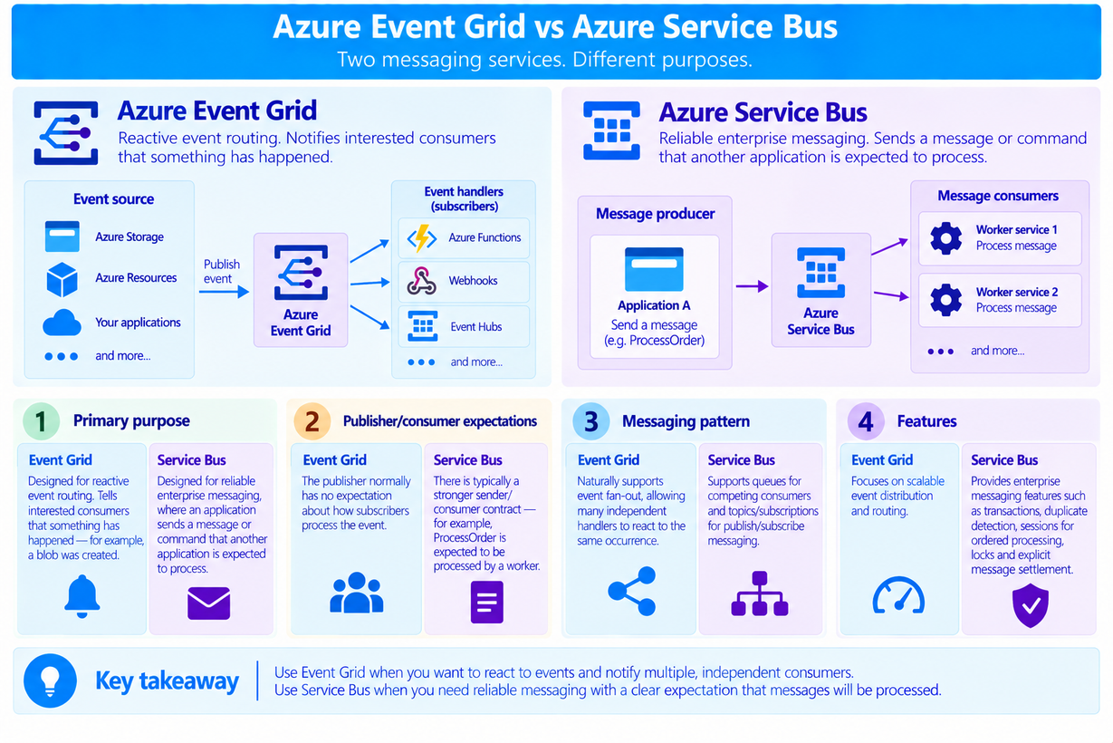
Azure Event Grid vs Azure Service Bus
  Event Grid is designed primarily for reactive event routing. It tells interested consumers that something has. Service Bus is designed for reliable enterprise messaging, where an application sends a message or command that another application is expected to process.
  With Event Grid, the publisher normally has no expectation about how subscribers process the event. With Service Bus, there is typically a stronger sender/consumer contract — for example, ProcessOrder is expected to be processed by a worker.
  Event Grid naturally supports event fan-out, allowing many independent handlers to react to the same occurrence. Service Bus supports queues for competing consumers and topics/subscriptions for publish/subscribe messaging.

